Slide 1
Enterprise Content Management
Jobs and Methods
Notes:
Place the audio notes for this slide here

Slide 2

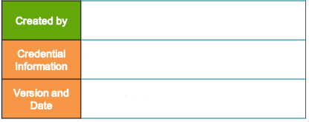
Mohammad Zabiulla (436572)
Senior Associate,
Enterprise Content Management Compétency
V 0.1, 15th February 2018
V 0.3 16th March 2018

Slide 3
Agenda
Overview
Creating Methods and Jobs
Running Methods and Jobs
Configuring Methods and Jobs
Troubleshooting
Summary

Slide 4
Overview

Slide 5

Overview : Methods
Methods are executable programs that are represented by method objects in the repository of type dm_method
They tend to automate complex processes like cleanup, report creation, migration etc compared to manually executing them.
The program can be a Docbasic script, a Java method, or a program written in another programming language such as C++.
Methods are executed by issuing a DO_METHOD administration method from the command line or using a job.

Slide 6
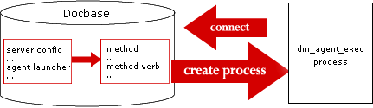
Overview : Methods
If the method is executed by the Java method server, app jar must be stored in the $DOCUMENTUM_SHARED\\server\DctmServer_ MethodServer\deploy\ServerApps.ear\DmMethods.war\WEB-INF\lib directory.
For workflow methods, the .jar files must be placed under the Process Engine deployment in the $DOCUMENTUM_ SHARED//server/DctmServer_MethodServer/deploy/bpm.ear/bpm.war/WEB-INF/lib directory

Slide 7

Overview : Jobs
Jobs are repository objects that automate method object execution as dm_job objects.
Methods associated with jobs are executed automatically on a user-defined schedule.
Jobs are invoked by the agent exec process.
Any user with System Administrator privilege can create jobs.
When a repository is created, it contains jobs for:
• Content • Data Dictionary • Distributed Content • Docbase • Federation • Fulltext • Other • Replication • Workflow

Slide 8
Summary
Methods are executable programs that are represented by method objects in the repository.
Jobs are repository objects that automate method object execution.
Methods associated with jobs are executed automatically on a user-defined schedule.

Slide 9
Test Your Understanding
Documentum methods belong to the type
dm_document
dm_folder
dm_method
All the above
Ans: c

Slide 10
Test Your Understanding
Documentum jobs belong to the type
dm_document
dm_folder
dm_job
All the above
Ans: c

Slide 11
Creating Methods and Jobs

Slide 12
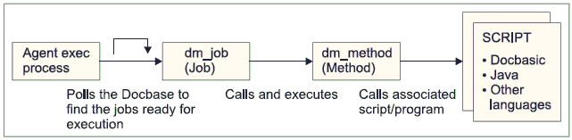
Creating Methods using DA:
To create or modify a method:
Connect to the repository where you want to create the method and navigate to
Administration > Job Management > Methods.
To create a new method, select File > New > Method.
Enter or modify the method information
Name - The method name.
Verb - The method verb is the command-line name of the procedure that executes the program file.
Method Type - Specifies the programming language of the method like dmbasic,dmawk,java,program.

Slide 13
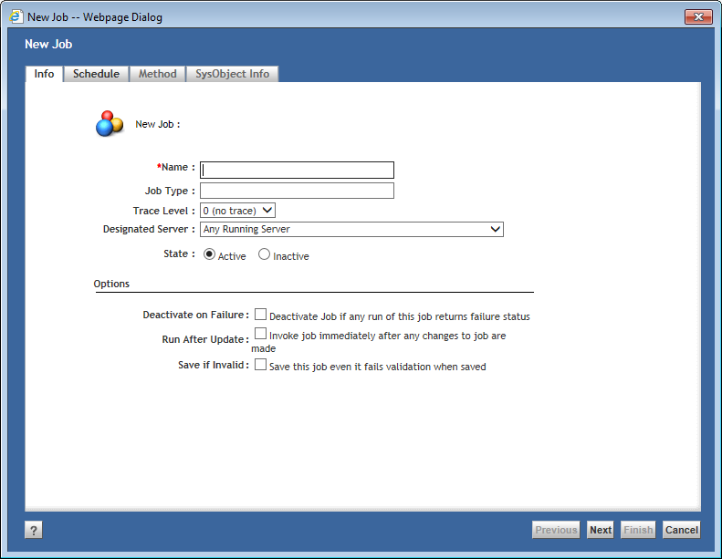
Creating Jobs using DA
To create a basic job:
Navigate to Administration > Job Management > Jobs.
Select File > New > Job.
Enter the general job information on the Info tab,
Click the Schedule tab and enter the job schedule information
Click the Method tab and enter the job method information
Click the SysObject Info tab and enter the job SysObject information,
Click Finish to save your changes

Slide 14
Job details
To assign a method to a job:
Click the Method tab on the New Job or Job Properties page.
Enter the method information
Click OK to save the changes.
Locating a method for a job
On the “Choose a method” page, select the method to be executed by a job.
To locate a method for a job:
Type the first few letters into the Starts with box and click Go.
To view additional pages of methods, click the forward or back buttons.
To sort the items, select Show All or Show System Methods from the drop-down list.
When you locate the correct method, select it and click OK.

Slide 15
Creating Methods
For BOF 1.0 the class must implement only the IDfMethod interface, the jar is deployed on JMS
For BOF 2.0 it also implements IDfModule because it will be deployed into the repository as a Module
Psuedo-Code:
public abstract class JobMethod implements IDfMethod, IDfModule {
public int execute(Map args, PrintWriter writer) throws Exception { try { } catch (Exception e) { } finally { if (session != null) sessionManager.release(session); } }

Slide 16
Creating Methods
There are a couple of reasons you might want to deploy Java server methods as BOF modules.
You want to deploy the implementation in the same dar/docapp as the dm_method definition
You want to avoid jar confusion by avoiding the java_methods directory
You want hot deployment for your method implementation
In order to deploy your method as a module you have to do the following:
Define a module by extending DfSingleDocbaseModule or have your module implement the marker interface IDfModule directly
Have your module implement IDfMethod – not IDmMethod (no interface jar)
Put the module name – not the class name – in the command_verb of the dm_method object
Make your module self-contained. You have no visibility to classes in the java_methods directory so you must be able to find anything you need in one or more BOF modules.

Slide 17
Summary
Methods can be created using Documentum Administrator
Administration > Job Management > Methods
Jobs can also be created using Documentum Administrator
Administration > Job Management > Jobs.
In terms of implementation, the Class can implement BOF 1.0 (IDfMethod interface) or BOF 2.0 ( IDfModule )

Slide 18
Test Your Understanding
It is better to execute ,methods as BOF modules since :
You want to deploy the implementation in the same dar/docapp as the dm_method definition
b) You want to avoid jar confusion by avoiding the java_methods directory
c) You want hot deployment for your method implementation
d) All of the above
Ans: d

Slide 19
Test Your Understanding
The command-line name of the procedure that executes the program file for a Method is called
Name
Schedule
Permission
Verb
Ans: d

Slide 20
Running Methods and Jobs

Slide 21
Running Jobs
To run a job using DA:
Select the job to run.
Click Tools > Run. When the agent exec process next polls the repository, the job runs.
To view the status of a running job after you start it, click View > Refresh.
To view the job report, select the job and click View > Report.
To view the trace log for the job, select the job and click View > Trace.
Viewing the status of a running job
To view the status of a running job after you start it, click View > Refresh.
The list page refreshes and the Status column for the job is updated.
You may need to click View > Refresh several times

Slide 22
Running Jobs
Using API/DQL -
API Editor • apply,c,NULL,DO_METHOD,METHOD,S,, ARGUMENTS,S,''
DQL Editor • EXECUTE do_method WITH method = '', arguments = ''
Viewing job reports
Connect to the repository and navigate to Administration > Job Management > Jobs.
Select the jobs whose reports you want to view.
Select View > Report (or right-click and select View Job Report).
If you selected multiple jobs, click Next to view the next report.
To view the report on Content Server, for instance on windows, navigate to D:/Documentum/dba/log/<repo id>/sysadmin/<job name.report>

Slide 23
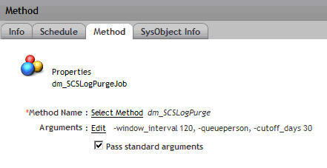
Running Methods
To run a method:
Navigate to Administration > Job Management > Methods.
Locate the method and then select
Tools > Run Method.
Enter information on the Run Method page:
Arguments: Type applicable arguments
Timeout: Type a time-out interval.
Save Results: Select to save the results.
Launch Direct: launches method directly
Launch Async: launches method asynchronously.
Run as Server: runs as the application owner.
Trace Launch: Saves execution messages to server

Slide 24
Some important Jobs
DMClean → The DMClean job removes deleted and orphaned objects from the Docbase.
DMFilescan → The DMFileScan job removes deleted and orphaned content files from the file system.
LogPurge → The Log Purge job removes server and session logs from the Docbase and file system.
ConsistencyChecker → The Consistency Checker job runs 77 referential integrity checks on the Docbase.
UpdateStats → The Update Stats job updates database table statistics and repairs fragmented tables
QueueMgt → The QueueMgt job deletes dequeued Inbox items from the Docbase.
StateOfDocbase → The State of the Docbase job produces a report of the repository environment and statistics about object types

Slide 25
Running Methods
To run a method:
Navigate to Administration > Job Management > Methods. The system displays the Methods list page.
Locate the method and then select Tools > Run Method. The system displays the Run Method page.
Enter information on the Run Method page:
a. Arguments: Type any arguments required by the method.
b. Timeout: Type a time-out interval.
c. Save Results: Select to save the results.
d. Launch Direct: Select to launch the method directly.
e. Launch Async: Select to launch the method asynchronously
f. Run as Server: Select to run the method as the application owner.
g. Trace Launch: Select to save method execution messages to the server log.
Click OK.

Slide 26
Viewing Results of Methods
Viewing the results of a method
The results of a method are displayed only after you run a method from Documentum Administrator.
After you run the method, the following method results appear:
The result returned, if any
Any document IDs that result
The process ID
Whether the method launched successfully
The return value, if any
Whether there were errors on the operating system from running the method
Whether the method timed out
The method timeout length
Click OK to exit the results page and return to the Methods list page.

Slide 27
Summary
Jobs can be run using DA:
Select the job to run. Click Tools > Run.
Using API :
API Editor • apply,c,NULL,DO_METHOD,METHOD,S,, ARGUMENTS,S,''
Using DQL :
DQL Editor • EXECUTE do_method WITH method = '', arguments = ''
To run a method using DA:
Administration > Job Management > Methods. Tools > Run Method.

Slide 28
Test Your Understanding
This job removes deleted and orphaned content files from the file system.
Log Purge
Consistency Checker
Data Dictionary
DMFile Scan
Ans : d

Slide 29
Test Your Understanding
This job produces a report of the repository environment and statistics about object types
StateOfDocbase
Log Purge
Consistency Checker
Data Dictionary
Ans : a

Slide 30
Configuring Jobs and Methods

Slide 31
Using Composer
To create a method:
In your Composer project, expand the Artifacts folder and right-click Methods. Select New > Method. The New Method dialog appears.
2. Enter a name for the new method or accept the default name and then click Finish. The Method editor appears

Slide 32
Using Composer
Enter the properties for the method, as described in the following table:
Parameter | Description
Name | A string specifying the name of the method. Do not use the format dm_methodname to name the method. This naming convention is reserved for default Documentum objects.
Type | Specifies the language or program used for this method. Select on of the following types: • java: The method is written in Java and the Java method server is executing the method. • dmbasic: The method is written in Docbasic. • dmawk: The method is written in dmawk. • program: The method is a program.
Command | The command that launches the method
Run Asynchronously | Specifies whether the procedure is run asynchronously or not. This parameter is ignored if the method is launched on the Method Server or Content Server and SAVE_RESULTS is set to TRUE on the command line.
Run Synchronously | Specifies whether the method is run synchronously

Slide 33
Using Composer
Enter the properties as below and save changes finally
Timeout | Specifies the minimum, default, and maximum amount of time before the methods times out
Run as the server | Specifies whether the method is run as the server account. If selected, the method is run as the server accoun
Trace launch | Specifies whether internal trace messages generated by the executing program are logged. If selected, the messages are stored in the session log
Use method server | Specifies whether to use the Method Server or Application Server to execute Dmbasic or Java methods. If selected, the Method Server or application server is used. If not selected, the Content Server is used
Launch directly | Specifies whether the program is executed by the operating system or exec API call. If selected, the server uses the exec call to execute the procedure. If the checkbox is cleared, the server uses the system call to execute the procedure.
Use as workflow method | Specifies whether this method is used in a workflow.

Slide 34
Using Composer
To create a job:
1. In your Composer project, expand the Artifacts folder and right-click Jobs. Select New > Job. The New Job dialog appears.
2. Enter a name for the new job or accept the default name, then click Finish.
The Job editor appears.

Slide 35
Using Composer
Enter the properties for the Job, as described in the following table:
Parameter | Description
Name | A string specifying the name of the method. Do not use the format dm_methodname to name the method. This naming convention is reserved for default Documentum objects.
Subject | A comment or description of the job
Method | The method that this job is automating. Click Select and select a method from the Documentum Method Artifact dialog or click Method to create a method for this job.
Method Data | Data that is used by the method associated with the job. This property is available for the method to read and write as needed during its execution. Enter the data in the method data field and click Add.
Standard Arguments | Select to pass the standard arguments to the method. The standard arguments are: • Repository owner • Repository name • Job ID • Trace level
Custom Arguments | Select to pass one or more custom arguments to the method. Enter the argument in the custom arguments field and click Add
Deactivate on Failure | Select to direct the application to stop running the job if the underlying method fails

Slide 36
Using Composer
Enter the properties as below and save changes finally
Trace Level | Controls tracing for the method. Any value other than 0 turns on tracing. By default the trace level is set to 0.
Make this Job Inactive | Select to inactivate the job.
Max Runs | Specifies the maximum number of times the job runs
Run once upon saving, then run as scheduled | Select to run the job immediately after you save it, then return to the configured schedule
Execute every | Specifies the number of times this job is run every minute, hour, day, or week.
Execute on | Specifies a day on which this job is run. The job can be run on the same day once every week, once every month, or once every year.

Slide 37

Custom Methods in Workflows

Slide 38
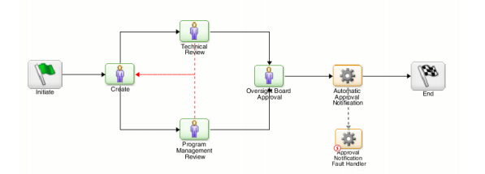
1.1 Structured and Unstructured content
Custom Method in Workflows
A process template consists of multiple activities.
Activities represent the tasks needed to complete the process, such as receiving an email, reviewing a document, checking it into the repository, or approving it.

Slide 39
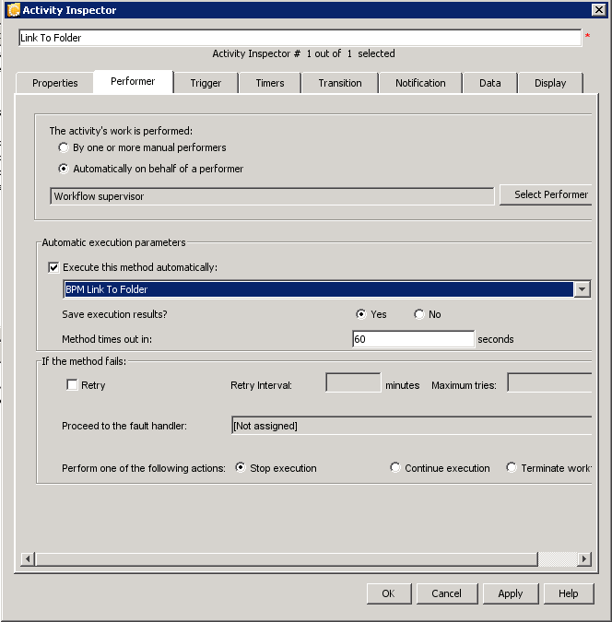
1.1 Structured and Unstructured content
Custom Method in Workflows
In order to execute Custom methods in workflows :
a. Select the checkbox “Execute this method automatically” to choose an automatic execution parameter from drop-down list. The actions in the drop-down list are workflow methods.
To make a custom method available here, the attribute a_special_app must be set to Workflow.

Slide 40
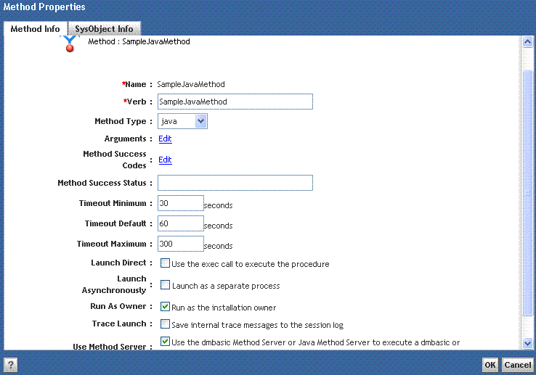
1.1 Structured and Unstructured content
Custom Method in Workflows
A Workflow Definition consists of multiple Activities which can be Manual or Automatic.
Manual Activities are performed by a Performer or a User.
Auto-Activity is generally performed by a program on behalf of a user (using a User’s session).
The program used for Auto-Activity has to follow certain guidelines:
Implement IDmMethod or WorkflowMethod and accordingly it should implement execute or doTask from the corresponding interface.
Its a_special_app property set to ‘Workflow’.
It can be created using Composer or DA + DQL.
The Manual activities are made available to the Performers in their inbox as task.

Slide 41
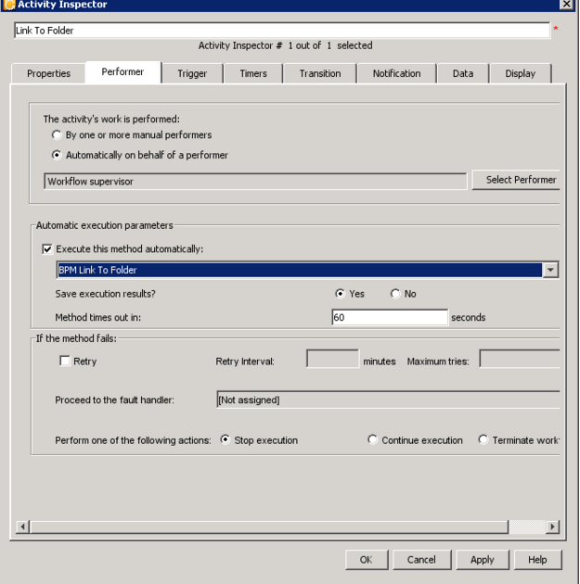
1.1 Structured and Unstructured content
Custom Method in Workflows

Slide 42
Summary
To configure a method using Composer
Expand the Artifacts folder and right-click Methods. Select New > Method.
To configure a job:
Expand the Artifacts folder and right-click Jobs. Select New > Job.
A process template consists of multiple activities.
A Workflow Definition consists of multiple Activities which can be Manual or Automatic
Auto-Activity is generally performed by a program on behalf of a user
The Manual activities are made available to the Performers in their inbox as task

Slide 43
Test Your Understanding
By default the method trace level is always set to :
100
10
5
0
Ans : d

Slide 44
Test Your Understanding
In order to execute a method as a workflow, which attribute needs to be set to WORKFLOW
object_name
title
a_special_app
a_content_type
r_object_type
Ans: c

Slide 45
Troubleshooting

Slide 46
Troubleshooting
When the agent_exec process launches a job, it passes four standard arguments to the job’s method
Standard Argument | Description
docbase_name | Name of the Docbase
user_name | Name of the user executing the job (usually the Docbase owner)
job_id | ID of the job object
method_trace_level | Trace level (default is 0, no trace)
In addition, the method can access additional arguments defined in the job object’s method_arguments attribute. When the method runs, it uses the job_id to retrieve these arguments from the job object. Two common arguments passed using this technique are
Method Argument | Description
queueperson | The user name who should receive email and notifications from the job. If the argument is blank, the job uses the user name defined in the operator_name attribute of the server config object (usually the Docbase owner)
window_interval | Defines (in minutes) a window on either side of a job’s scheduled execution time in which it can run. If the Content Server is down during the scheduled execution time of a job, the agent_exec will try to run the job when the Content Server restarts.

Slide 47
Troubleshooting
To change the trace level of a job, use DQL: update dm_job object set method_trace_level = where object_name = ''
To determine which jobs are currently running, use this DQL: select object_name, r_object_id, a_last_invocation from dm_job where a_special_app = 'agentexec‘
To stop a currently executing job, terminate its process in the Windows Task Manager
Determine the job’s process id (PID) with DQL:
Select object_name, r_object_id, a_last_invocation, a_last_completion, a_last_process_id, a_current_status from dm_job where a_special_app = 'agentexec' order by a_last_process_id
Then, terminate the job’s PID in the Window’s Task Manager.
Manually reset the status attribute of the dm_job object.
update dm_job object set a_special_app = '', set a_current_status = 'ABORTED', set a_last_completion = DATE(TODAY) where object_name = ''

Slide 48
Troubleshooting
Sample job : DMClean
DMClean (dm_DMClean) looks for and deletes orphaned content objects (dm_sysobject), ACLs (dm_acl), annotations (dm_note) and SendToDistributionList workflow templates.
When the DMClean job runs, it generates an API script in %DOCUMENTUM%/dba/log/ /sysadmin named .bat and then executes the script to delete the objects.
API apply,c,NULL,DO_METHOD,METHOD,S,dmclean, ARGUMENTS,S, '-clean_aborted_wf -clean_now'
DQL EXECUTE do_method WITH method = 'dmclean', arguments = '-clean_aborted_wf -clean_now'
Outputs In addition to the API script, the DMClean job generates a report of its activity and saves it to /System/Sysadmin/Reports/DMClean in the Docbase

Slide 49
Summary
When the agent_exec process launches a job, it passes four standard arguments to the job’s method
Jobs generate script in %DOCUMENTUM%/dba/log/ /sysadmin
Updating the trace level of a job gives more information about its execution
Job generates execution report of its activity and saves it to /System/Sysadmin/Reports/

Slide 50
Test Your Understanding
When the agent_exec process launches a job, it passes one of these standard arguments to the job’s method
ACL name
Group Name
Job description
user_name
Ans : d

Slide 51
Test Your Understanding
A job generates a report of its activity and saves it to the following location in the Docbase
/System/Sysadmin/Reports
/System/Sysadmin/Admin
/System/Sysadmin/Test
/System/Sysadmin/Dump
Ans : a

Slide 52
Overall Summary

Slide 53
Summary
A method is an object in the docbase that lets you launch a program on the server without being logged into the server.
Instead, you issue a DQL or API command from inside a Documentum client, and Documentum will launch the program for you. You can even pass the program arguments and get a return code back.
There are two main reasons to use server-side methods: to allow normal users to execute a command that only a superuser can execute, and to off load processor-intensive tasks from the client to the server
There are multiple ways to execute a method: using DQL and using the API, Using DA, using a JOB

Slide 54
Summary
Jobs in Documentum are used to automate the execution of a program or script.
Each job in Documentum represents an automation schedule and execution frequency for something called a method, which in turn holds the reference to the program or script to execute.
Jobs are configured in Documentum Administrator (DA) under Administration->Job Management->Jobs.
To view the properties, schedule, method, and object information for a job, click on the information icon in DA.
The method uses these arguments to log into the docbase to accomplish its intended purpose.

Slide 55
Hands On

Slide 56
HandsOn : Method
Create a cutom documentum method,
Check if a particular folder is empty
Delete the folder if empty
List out the folder contents to a text report file if folder is not empty
Create a custom workflow method
In this method checkout the document that is attached to this particular workflow package.
Implement this in the workflow autoactivity

Slide 57
HandsOn : Job
Use the folder deletion method created earlier and create a custom job that polls a given docbase location periodically
Purge empty folders recursively
List out folder contents if folder is not empty

Slide 58
References
https://knowledge.opentext.com/knowledge/cs.dll/fetch/2001/3551166/27085930/69125280/66215269/68909853/Documentum_Server_7.1_Administration_and_Configuration_Guide.pdf?nodeid=68898842&vernum=1
https://knowledge.opentext.com/knowledge/cs.dll/fetch/2001/3551166/27085930/69125280/66201762/69330464/Documentum_Administrator_7.1_User_Guide.pdf?nodeid=69348882&vernum=1
https://knowledge.opentext.com/knowledge/cs.dll/fetch/2001/3551166/27085930/69125280/66215065/68601343/Documentum_Composer_7.1_User_Guide.pdf?nodeid=68599892&vernum=1
https://knowledge.opentext.com/knowledge/cs.dll/fetch/2001/3551166/27085930/69125280/66215269/68909853/Documentum_Server_7.1_Fundamentals_Guide.pdf?nodeid=68910066&vernum=1

Slide 59
You have successfully completed
Jobs and Methods
Notes:
Place the audio notes for this slide here

